Slide 1
Bacteria C
Kwin Kellar, Cody Kotara, James Jewett, Raven Garcia, Yolanda Ayala, and Asam Charolia

Slide 2
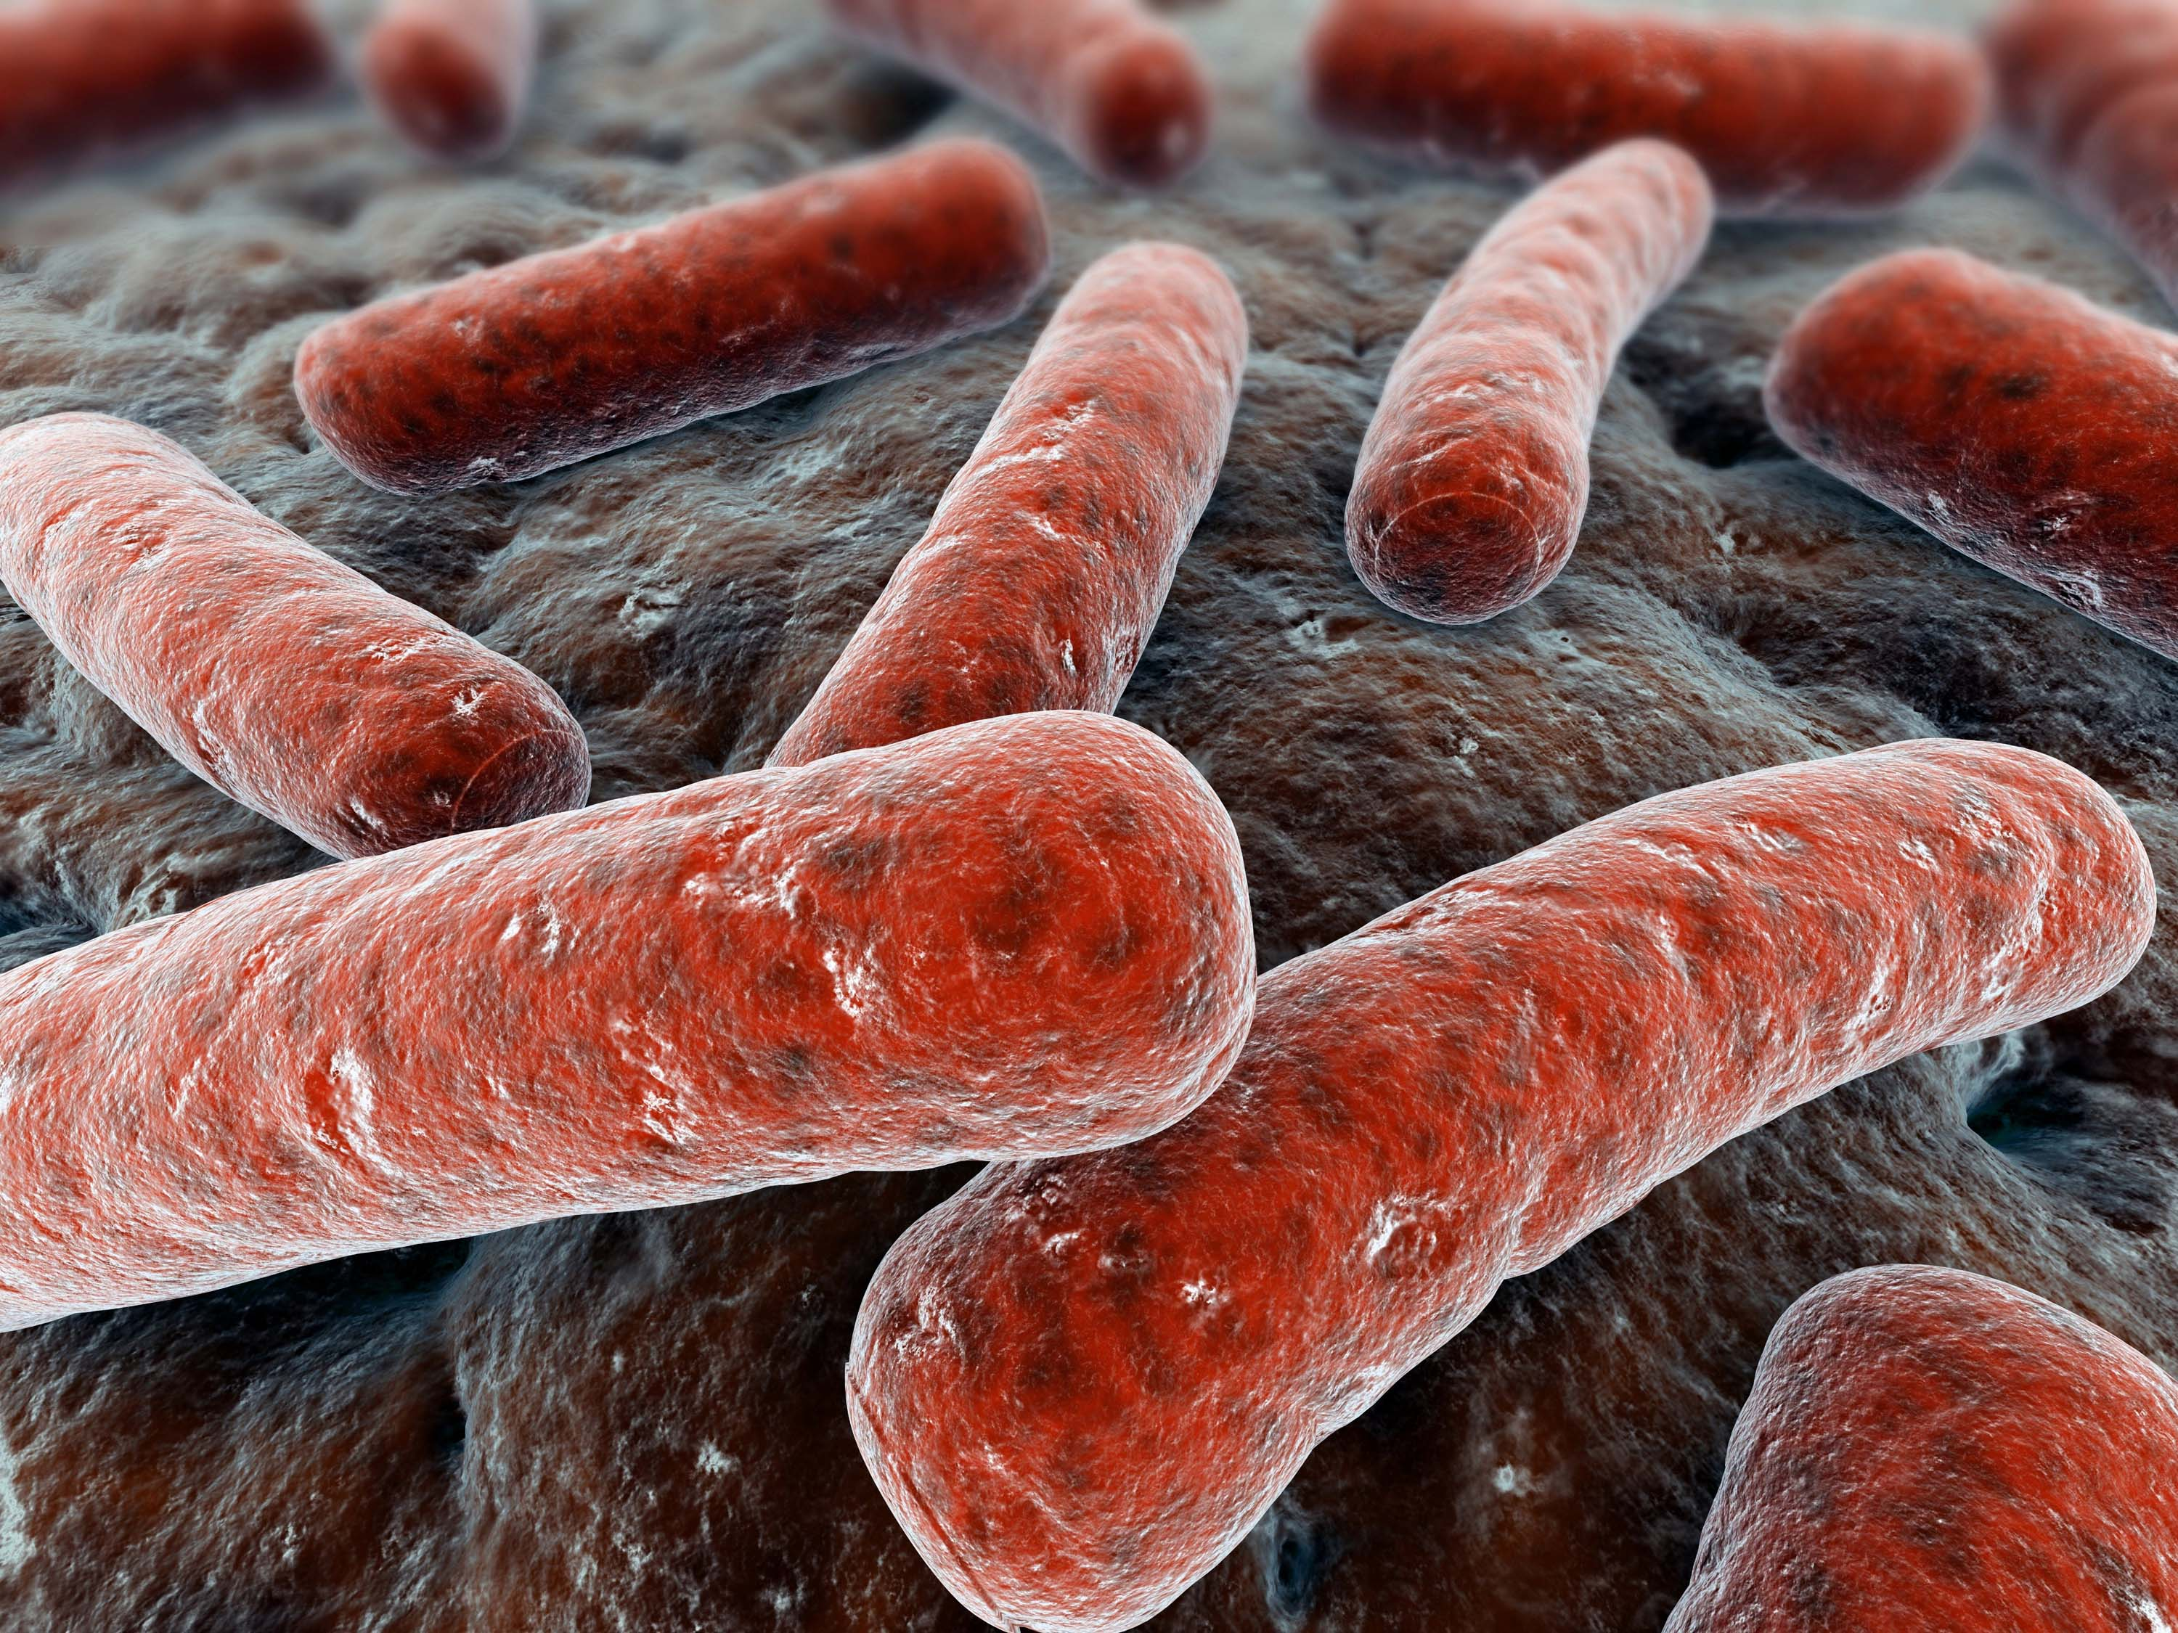
Mycobacterium

Slide 3
Legionella Pneumophia
Naturally live- Legionella is a type of bacterium found naturally in freshwater environments like lakes, and streams.
Region- Legionella Pneumophia was first an outbreak in the USA in 1976, however It has since been associated with outbreaks linked to poorly maintained artificial water systems, particularly cooling towers or evaporative condensers associated with air conditioning and industrial cooling, hot and cold-water systems in public and private buildings, and whirlpool spas.
Reservoir- Composite facilities appear to compromise an important reservoir for legionellae. However, this bacteria tends to grow very well in all kinds of fresh water sources that are not treated.

Slide 4
Host Range- The host range of L. pneumophila is extensive because the bacterium is capable of replicating in at least 15 different species of amoebae. When contaminated water sources are aerosolized and inhaled by humans, L. pneumophila replicates in alveolar macrophages, causing a potentially fatal form of pneumonia. Mainly Lungs
Disease- Legionella Pneumophia normally causes legionnaires disease which is a severe form of pneumonia- lung inflammation caused by infection. Can also cause Pontiac fever which is a fever with muscle aches, if someone is suffering from Pontiac fever they will not have pneumonia from Legionella Pneumophia. Most healthy people are not at risk of Legionella Pneumophia affecting them.
Infectious dose- 10³ to 10⁸ CFU/g

Slide 5
Infectious dose- 10³ to 10⁸ CFU/g.
Mode of Transmission- After legionella grows and multiplies in a building water system, the contaminated water then has to spread into small droplets that people then have to breathe in, people get this bacteria when they breath it in through small droplets of water that contain the bacteria

Slide 6
Legionella longbeachae
Naturally Live- In potting soil or compost
Region- First ever case was found in long beach California, but it is very common in Australia. Cases have also been documented in the United states, Japan, Greece, and the UK.
Reservoir- The primary environmental reservoir of L. longbeachae remains unknown; however, the major source of human infection is considered to be commercial potting mixes and other decomposing materials, such as bark and sawdust
Host Range- . The ability of L. longbeachae to infect protozoan and metazoan hosts allows for long-term contamination of environmental sites

Slide 7
Legionella longbeachae
Disease- L. longbeachae generally causes infection of the lung (pneumonia), which is a severe illness.
Symptoms of Legionella infection may include: Fever, cough, chest pain, and breathlessness
Infectious Dose- The lethal dose varies from 2400 to 100000 viable bacteria, but infection can be initiated by as few as 130 organisms

Slide 8
Mode of Transmission- The real mode of transmission has yet to be fully discovered however scientists believe that once the bacteria has grown in the potting soil it then may be inhaled and that is how the bacteria is transmitted. There are no cases of human to human transmission.

Slide 9
Mycobacteria Characteristics
Aerobic, nonmotile, nonsporing, slow growing (2-60 days) rod shaped bacteria characteristically acid-fast (i.e. after staining they resist decolorization with acidified alcohol or with strong mineral acids). To a limited extent staining by Gram method is weak.
Branched filaments are formally occasionally
No aerial mycelium is formed
Outer membrane, capsules
Lack formation of endospores with the exception of M. bovis
Reaction to penicillin, usually resistant

Slide 10
Mycobacterium Leprae
Commonly known as leprosy
World’s oldest disease
Acid fast, rod shaped bacillus

Slide 11
M. Leprae
Natural Environment: warm tropical countries such as SE Asia, Americas, and Africa
Reservoir: Humans and armadillos

Slide 12
Infectious Dose: 7 billion organisms per gram of tissue

Slide 13
M. Leprae
Mainly affects the skin, peripheral nerves and the mucosa of the respiratory tract
Transmission through the respiratory cough by sneezing, coughing, etc.
Region: cold regions of the human body such as: nose, feet, hands(extremities); peripheral nervous system

Slide 14
Mycobacterium
Tuberculosis
Natural environment: soil, and water sources (bogs, surface water, ground water, and sea water)
Region: worldwide but primarily Asia and Africa

Slide 15
M. Tuberculosis
Reservoir: Humans are the only known reservoirs
Host Range: primarily pulmonary(lungs)
Predisposing and Occupational Risk: This disease is easily transmitted from an infected individual to a healthy individual. About 1/3 of the population has the latent form of tb; Tuberculosis may persist for a lifetime as a latent infection or become active when host immune defenses are suppressed
Infectious Dosage: only a few germs need to be inhaled to be infected

Slide 16
Mode of transmission: through the air; if an individual with TB coughs, sneezes, or spits they propel germs into the air

Slide 17
Mycobacterium Tuberculosis complex (MTBC)
M. canetti
M. microti
M. caprae
M. africanum
M. bovis
M. pinnipedii

Slide 18
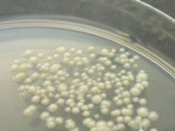
M. canetti
George Canetti (1911-1971)
“M. canettii” is characterized by eugonic growth, with smooth, white, glossy colonies on solid medium. Its biochemical characteristics indicate that it is unable to produce niacin, but it is capable of nitrate reduction and has positive urease, Tween 80 hydrolysis, and catalase activities (at 22°C, although not after heat inactivation at 68°C).
Generation time shorter compared to M. tuberculosis
Natural reservoir, host range, and mode of transmission still unknown

Slide 19
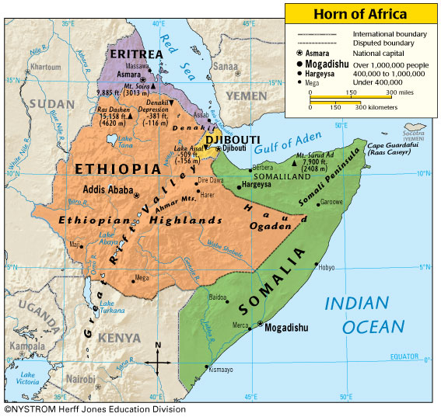
M. canetti
Location An emerging disease in the Horn of Africa
Geographic distribution and prevalence of M. canetti are likely underestimated
water-droplet aerosolized pathogens

Slide 20
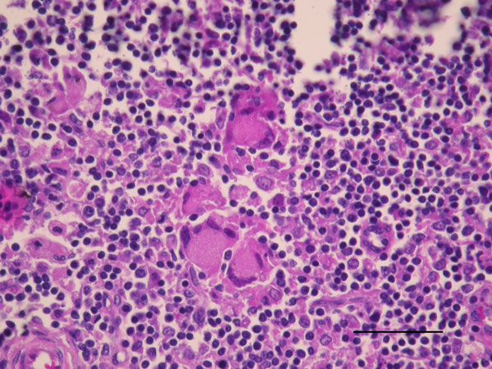
M. microti
Also known as vole bacillus
Reservoir –small rodents such as voles, shrews and wood mice
Sporadic cases have included domestic and wild animals
1998 First human case of pulmonary tuberculosis
Location United Kingdom, Western Europe
Human infections are rare, but do occur
Fig. Goat lymph node granuloma with numerous Langhans-type multinucleated giant cells from a goat in France infected with Mycobacterium microti (hematoxylin and eosin stain). Scale bar indicates 50 μm.

Slide 21
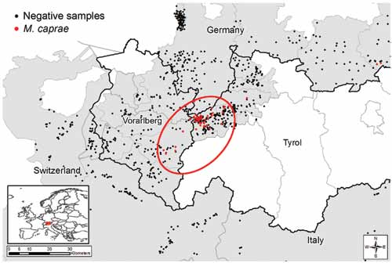
M. caprae
Formerly known as M. tuberculosis subsp. and M. bovis
Designated as a new species in 2003
Location: predominantly found in Central and Western European countries
Pathogen can effect both animals and Humans (i.e. species cattle, Red deer, fox and Humans
Lack of knowledge about transmission of infection between domestic and wild animals
Figure 2. Statistically evident spatial cluster of Mycobacterium caprae–positive red deer in the Alpine region, 2009-10, 2010- 2011, and 2011-12 hunting seasons. Area in red circle contained significantly more M. caprae–positive red deer than the remaining study area (p<0.001). Inset shows location of Austria and Germany within Europe (shading).

Slide 22
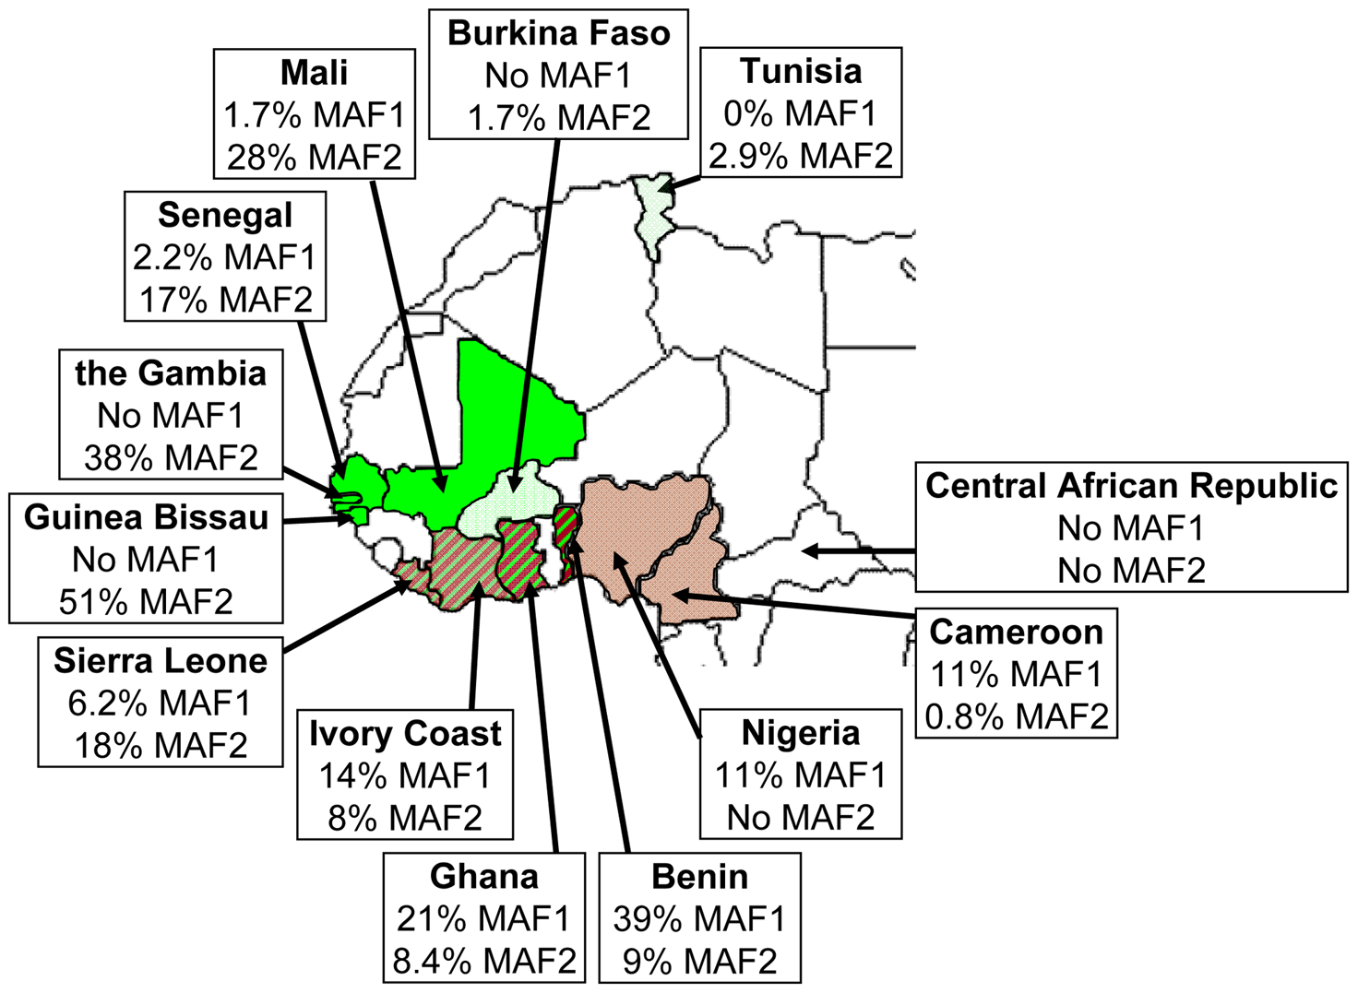
M. africanum
Discovered in 1968, mycobacterial strains in biochemical testing were intermediates between M. tuberculosis and M. bovis
Geographic range West Africa, East Africa,
Distinct genotypic profiles of the two major clades of Mycobacterium africanum:
M. African Type 1 West Africa
M. African Type 2 East Africa
Has been found in animals, including monkeys, cows, pigs and hyrax
Figure 3. M. africanum prevalence in Western African countries.

Slide 23
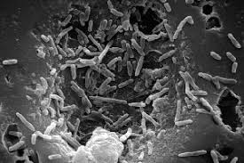
M. bovis
Causative agent of tuberculosis in cattle, humans, other mammals
Can be transmitted from human to human contact
Geographic range: New Zealand, United Kingdom, United States
Mode of transmission of M. bovis to humans is believed to be from cattle via consumption of unpasteurized dairy products
Resistant to pyrazinamide
Courtesy CDC

Slide 24
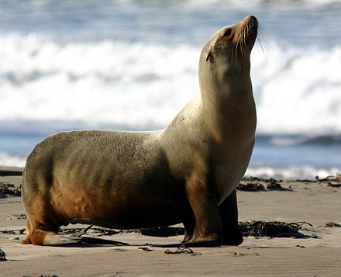
M. pinnipedii
In 1913, initial case described of tuberculosis in pinnipeds
Affects marine mammals, primarily southern sea lion
Seals serve as a vector for transmission of tuberculosis
Geographic range is worldwide
Mode of transmission has been seen in animals, and humans.

Slide 25
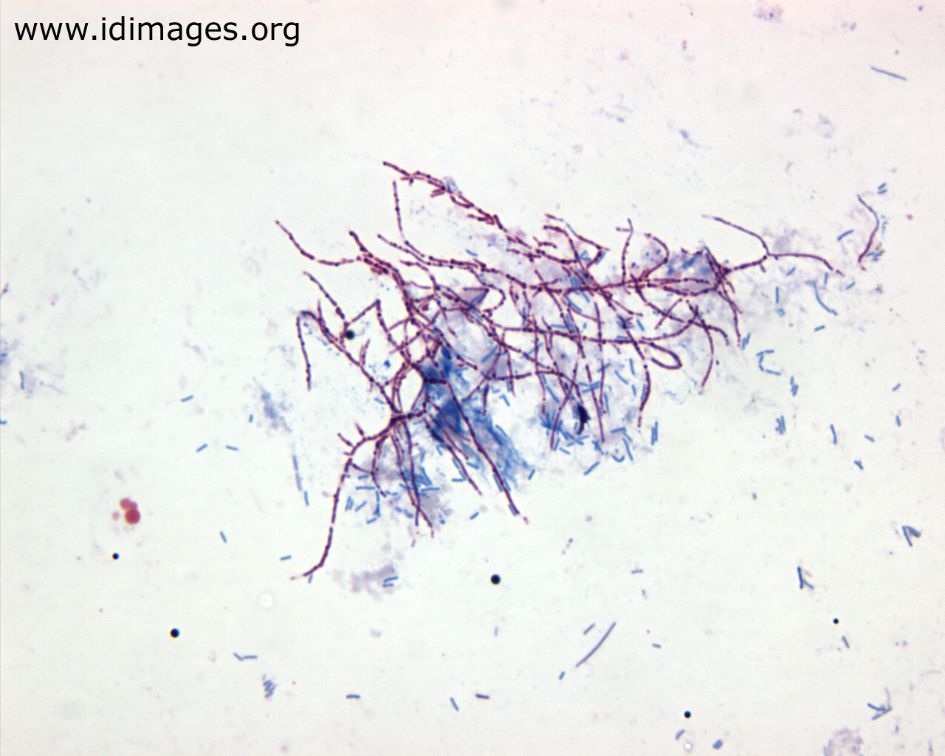
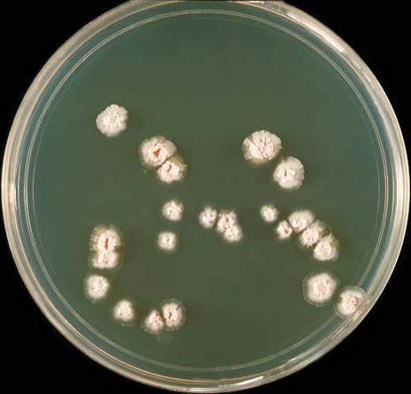
Nocardia spp.
Where does it live - dead decaying organic matter in the soil, water, dust and vegetation
Soil – breaks down the decaying organic matter in the soil into simple substances that can be used by plants and other organisms that inhabit the soil
Reservoir – soil, aquatic habitats and decaying organic matter
Host Range – Humans and animals (cattle, cats, dogs, chickens, ducks, fish, goats sheep and swine) have been shown to carry the bacterium
http://www.idimages.org/atlas/organism/?atlasentryID=10&organism=Nocardia

Slide 26
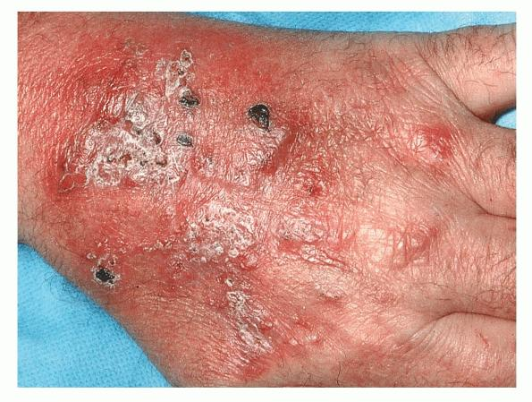
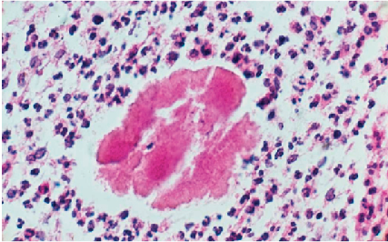
Predisposing & Occupational Risks – working in soil w/o use of gloves and protective; increased risks of lacerations that allow the entrance of the bacteria
Disease – Nocardiosis – rare disorder that affects the lungs, brain, skin and other organs
  Prevalent in patients with:
    Weakened immune systems
    HIV/AIDS patients
  Signs/Symptoms
    Skin ulcers, fever, weight loss, night sweats, cough
Mode of Transmission – Inhalation of the bacteria by other organisms, the bacteria can enter the body when working in the soil or a hospitalized patient can be infected by contaminated medical equipment or bacteria into a wound during surgery
http://www.primehealthchannel.com/wp-content/uploads/2013/01/Nocardiosis-Image.jpg
https://www.the-dermatologist.com/sites/default/files/issues/Screen%20Shot%202013-10-15%20at%203.44.33%20PM_0.png

Slide 27
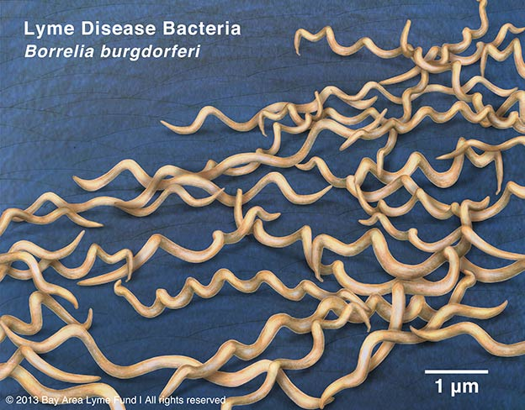
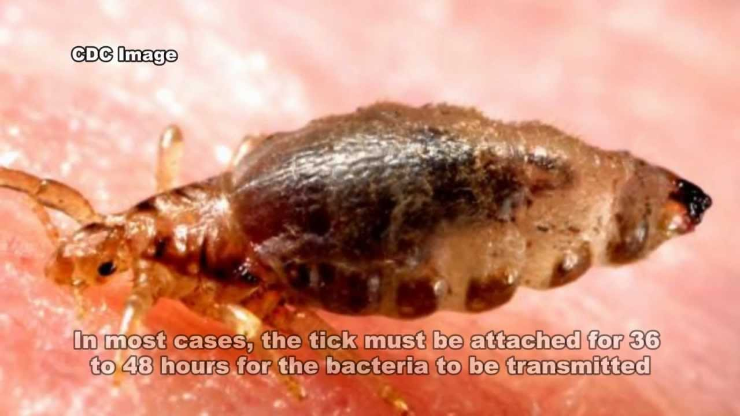
Borrelia burgdorferi
Where does it live – it is an endoparasite; lives inside its host
  Mainly found in the Northern Hemisphere
Reservoir – Deer, wild rodents and tick through transstadial transmission
  Lxodes ticks – carry the bacteria and can disperse it when it bites your or bites into other mammals
Pre Occupational Risks – in/around standing water, swamps, deep wilderness

Slide 28
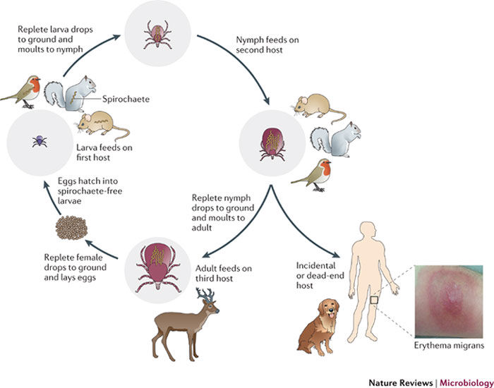
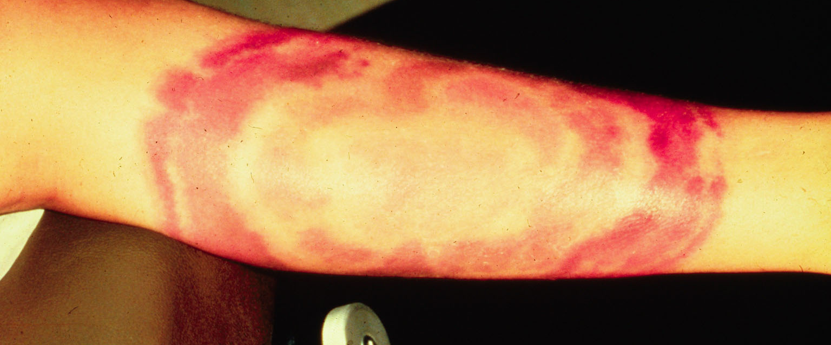
Disease – Lyme Disease – transmitted from ticks
  Begins with an area of expanding redness on the surface of the skin, known as erythema; begins at the site of a tick bite around 1 week after the initial bite occurs
  Early symptoms (3-30 days): Fever, headache, chills, and rash
  Later symptoms (days to month after bite): severe headaches, shooting pains, numbness, nerve pain, heart palpatations

Slide 29
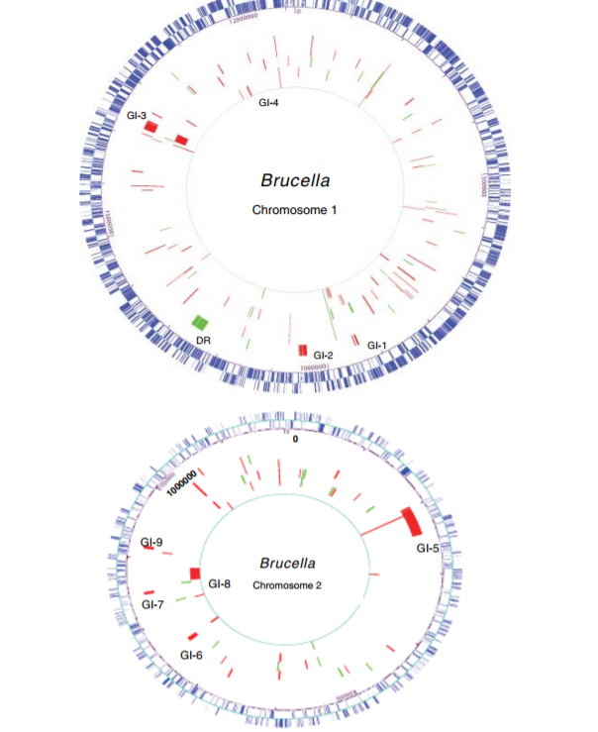
Brucella: abortus, melitensis, suis, and canis
The genus Brucella is made up of about six species
These six species are unique because of their biochemical antigenic properties
  Antigenic characteristics are when any substance cause the production of antibodies
Also, unique for their preference of hosts.
Species
  B. abortus
  B. melitensus
  B. suis
  B. canis
  B. ovis
  B. neotomae

Slide 30
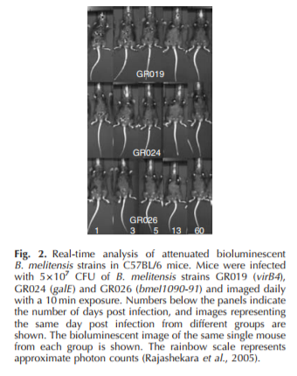

B. abortus: found in cattle (moderate pathogenicity)
B. melitensus: found in goats/sheep (highest pathogenicity)
B. suis: found in pigs (high pathogenicity)
B. canis: found in dogs (moderate pathogenicity)
B. ovis: found in sheep
B. neotomae: found in wood rats
Each of these species can cause similar effects
Pathogenic bacteria
Animal and human hosts infected with Brucella do not die

Slide 31
Brucellosis is a zoonotic endemic
  Can be known to cause osteoarthritis, endocarditis and several neurological disorders
  Can be characterized by abortion, sterility, and chronic infections
  Aerobic facultative intracellular bacteria.
  Brucella species are closely related to intracellular symbionts and pathogens of plants and animals and are classified as a2-proteobacteria based on rRNA sequence comparison
Humans can get this infection by the transmission from animals to humans by ingestion through infected food products, direct contact with an infected animal, or inhalation of aerosols (. The disease is an old one that has been known by various names, including Mediterranean fever, Malta fever, gastric remittent fever, and undulant fever

Slide 32
Yersinia Enterocolitica/pseudotuberculosis
Where is it found?
Sources of the organism is typically found in the intestinal tracts and colon of infected animals and poultry
Where is it found naturally?
Natural environment: soil, and water sources (bogs, surface water, ground water, and sea water)

Slide 33
Yersinia Enterocolitica/pseudotuberculosis
Mode of Transmission?
Human-human transmission has been reported rarely
nosocomial infections and blood transfusion related infections have been reported.
Fecal-oral transmission from animal to human or consumption of contaminated foods and untreated water are the most common modes of transmission.

Slide 34
Yersinia Enterocolitica/pseudotuberculosis
Who is at risk?
Occurs among small infants and small children; Highest rate in cold season climates
Host range?
Both diseases are primarily zoonotic diseases including a wide range of hosts. Found in humans, domesticated birds, mammals, and household pets.
Reservoir?
Pigs are the most typical reservoir host although the bacterium has been found in several warm blooded animals (Cows, dogs, etc.)

Slide 35
Yersinia Enterocolitica/pseudotuberculosis
What are the diseases?
Enterocolitis- inflammation of the small intestine; Acute diarrhea; Terminal ileitis; Mesenteric lymphadenitis; Pseudoappendicitis; Gastroenteritis; Appendicitis

Slide 36
Streptococcal Species
Where is it found?
Streptococcus found in various areas of the body depending on group
  Group A Streptococcus pyogenes (ß-haemolytic): Commonly found in nose, throat, and on the skin
  Group B Streptococcus agalactiae (ß-haemolytic): Found normally in the intestine, vagina, and rectal area
  Streptococcus pneumonia/viridans: commonly found in nose and throat, upper respiratory tract, genital tract, regions of gastrointestinal tract, and oral cavity
Where is it found naturally?
Streptococcus naturally lives on various areas of the body such as the throat, nose, middle ear. Many are harmless.

Slide 37
Streptococcal Species
Mode of transmission?
  Group A Streptococcus pyogenes (ß-haemolytic):Typically transmitted through large respiratory droplets or direct contact with infected people or carriers.
  Group B Streptococcus agalactiae (ß-haemolytic): this group tends to only new born babies as the bacteria can be passed sexually from baby to mother during birth.
  Streptococcal infection may occur in a result of ingestion of contaminated foods, such as milk products. For example, cows infected by humans can act as an intermediate host and pass the bacterium in their milk to infect other humans.

Slide 38
Streptococcal Species
Who is at Risk?
premature birth, being part of multiple birth, having a mother with a history of group B streptococcal infection, babies under six months’ old, adults over 75 years’ old, adults with week immune system.
Host Range
Streptococci are primarily a human pathogen; some have broad range of host including domesticated animals.
Reservoir
Reservoir: Humans are the primary reservoir for streptococcus and cattle (in some cases)

Slide 39
Streptococcal Species
What are the diseases?
  Group A Streptococcus pyogenes (ß-haemolytic) Pharyngitis (strep throat), Impetigo, Necrotizing Fasciitis, Erysipelas and cellulitis, Scarlet Fever, Streptococcal Toxic Shock Syndrome
  Group B Streptococcus agalactiae (ß-haemolytic): Urinary tract infection, Infection of the placenta and amniotic fluid, Sepsis, Cellulitis, Pneumonia
  Streptococcus pneumoniae and viridans: Sinusitis, Middle ear infections, Meningitis, Pneumonia, Bacteremia
Infectious Dose?
Typically, higher than 10^7

Slide 40
References
Legionella Pneumophia and L. longbeachae
  “Legionella (Legionnaires' Disease and Pontiac Fever).” Centers for Disease Control and Prevention, Centers for Disease Control and Prevention, 31 May 2016, www.cdc.gov/legionella/about/index.html.
  “Legionella Longbeachae Infection - Including Symptoms, Treatment and Prevention.” SA Health, www.sahealth.sa.gov.au/wps/wcm/connect/public+content/sa+health+internet/health+topics/health+conditions+prevention+and+treatment/infectious+diseases/legionella+longbeachae+infection.
Nocardia spp. And Borrelia burgdorferi
  -Brown , Barbara A. , et al. “Clinical and Laboratory Features of the Nocardia spp. Based on Current Molecular Taxonomy.” Clinical Microbiology Reviews , American society for microbiology , 1 Apr. 2006, cmr.asm.org/content/19/2/259.full.
  McNeil , Michael M , and June M Brown . “Nocardia Species (Nocardiosis).” Antimicrobe , 2010, www.antimicrobe.org/b117.asp#top.
  Jacobs , Steve . “Lyme Disease (Department of Entomology).” Department of Entomology (Penn State University), May 2013, ento.psu.edu/extension/urban/lyme-disease.
  Tilly, Kit, Patricia A. Rosa, and Philip E. Stewart. “Biology of Infection with Borrelia
  Burgdorferi.” Infectious disease clinics of North America 22.2 (2008): 217–234. PMC. Web. 15 Nov. 2017.
Mycobacterium Tuberculosis complex (MTBC)
  Bacteriophage. (2012). In B. W. Lerner & K. L. Lerner (Eds.), In Context Series. Biotechnology: In Context (Vol. 1, pp. 47-49). Detroit: Gale. Retrieved from http://uiwtx.idm.oclc.org/login?url=http://go.galegroup.com/ps/i.do?p=GVRL&sw=w&u=txshracd2623&v=2.1&id=GALE%7CCX4020200027&it=r&asid=1cca004ae131e12877d496abba13b1c0
  De Jong, B. C., Antonio, M., & Gagneux, S. (2010). Mycobacterium africanum—Review of an Important Cause of Human Tuberculosis in West Africa. PLoS Neglected Tropical Diseases, 4(9), e744. http://doi.org/10.1371/journal.pntd.0000744
  Michelet, L., de Cruz, K., Phalente, Y., Karoui, C., Hénault, S., Beral, M....Boschiroli, M. L. (2016). Mycobacterium microti Infection in Dairy Goats, France. Emerging Infectious Diseases, 22(3), 569-570. https://dx.doi.org/10.3201/eid2203.151870.
  Mostowy, S., Onipede, A., Gagneux, S., Niemann, S., Kremer, K., Desmond, E. P., … Behr, M. (2004). Genomic Analysis Distinguishes Mycobacterium africanum. Journal of Clinical Microbiology, 42(8), 3594–3599. http://doi.org/10.1128/JCM.42.8.3594-3599.2004
  Pfyffer G. 2015. Mycobacterium: General Characteristics, Laboratory Detection, and Staining Procedures*, p 536-569. In Jorgensen J, Pfaller M, Carroll K, Funke G, Landry M, Richter S, Warnock D (ed), Manual of Clinical Microbiology, Eleventh Edition. ASM Press, Washington, DC. doi: 10.1128/9781555817381.ch30
Brucella: abortus, melitensis, suis, and canis
  Rajashekara, G., Eskra, L., Mathison, A., Petersen, E., Yu, Q., Harms, J., & Splitter, G. (2006). Brucella: Functional genomics and host-pathogen interactions. Animal Health Research Reviews, 7(1-2), 1-11.
Mycobacterium leprae and M. tuberculosis
  “Leprosy (Hansen’s Disease) - Including Symptoms, Treatment and Prevention.” SA Health, www.sahealth.sa.gov.au/wps/wcm/connect/Public+Content/SA+Health+Internet/Health+topics/Health+conditions+prevention+and+treatment/Infectious+diseases/Leprosy/Leprosy+Hansens+Disease+-+including+symptoms+treatment+and+prevention.
  “Environmental Health and Safety.” Mycobacterium Tuberculosis | Environmental Health and Safety, ehs.research.uiowa.edu/mycobacterium-tuberculosis.
Streptococcal Species and Yersinia Enterocolitica/ pseudotuberculosis
  “Streptococcal Infections - Infections.” Merck Manuals Consumer Version, www.merckmanuals.com/home/infections/bacterial-infections/streptococcal-infections.
  Canada, Public Health Agency of. “Pathogen Safety Data Sheets: Infectious Substances – Streptococcus Pyogenes.” Canada.ca, 18 Feb. 2011, www.canada.ca/en/public-health/services/laboratory-biosafety-biosecurity/pathogen-safety-data-sheets-risk-assessment/streptococcus-pyogenes.html.

